Slide 1

Testing and GitHub Actions
P&G DevSchool
Presenter:​Ana

Slide 2
Testing
P&G DevSchool
Presenter:​Ana

Slide 3
Testing
Why Testing
Fundamental aspect of software development
Ensures that the code behaves as expected
Helps identifying bugs early
Improves code quality
Facilitates maintaining the reliability of the software
Provides documentation for the code
Makes the code easier to understand and maintain
P&G DevSchool
Presenter:​Ana

Slide 4
Testing
Types of Tests
Unit Tests
Integration Tests
End to End Tests
Focus on individual components or functions of the code.
They are fast and isolate each part of the codebase.
Test the interaction between different components or systems.
They ensure that integrated parts work together as expected.
Simulate real user scenarios to test the entire application flow.
They validate the system as a whole, but are usually slower and more complex.
P&G DevSchool
Presenter:​Ana

Slide 5
Exercise
Identify each type of tests for the given scenarios
You want to simulate a complete production cycle from raw material input to finished product output and verify the overall system performance.
Unit Tests
You have a function that calculates the efficiency of a production line based on input parameters like speed and downtime.
Integration Tests
You need to ensure that the data flow between the production line simulation module and the inventory management system works correctly.
End to End Tests
P&G DevSchool
Presenter:​Ana

Slide 6
Exercise - Solution
Identify each type of tests for the given scenarios
You want to simulate a complete production cycle from raw material input to finished product output and verify the overall system performance.
Unit Tests
You have a function that calculates the efficiency of a production line based on input parameters like speed and downtime.
Integration Tests
You need to ensure that the data flow between the production line simulation module and the inventory management system works correctly.
End to End Tests
P&G DevSchool
Presenter:​Ana

Slide 7
Unit Testing
Tools and Libraries
unittest
pytest
A built-in Python module that provides a framework for writing and running tests.
It is inspired by JUnit and is part of the Python Standard Library.
A powerful testing framework that simplifies writing small tests yet scales to support complex functional testing.
It offers features like:
Fixtures
Parameterized testing
Easy integration with other tools.
P&G DevSchool
Presenter:​Ana

Slide 8



Exercise
Set up a Python virtual environment and install pytest.
Create a virtual environment
2. Activate the virtual environment:
3. Install Pytest
P&G DevSchool
Presenter:​Ana

Slide 9
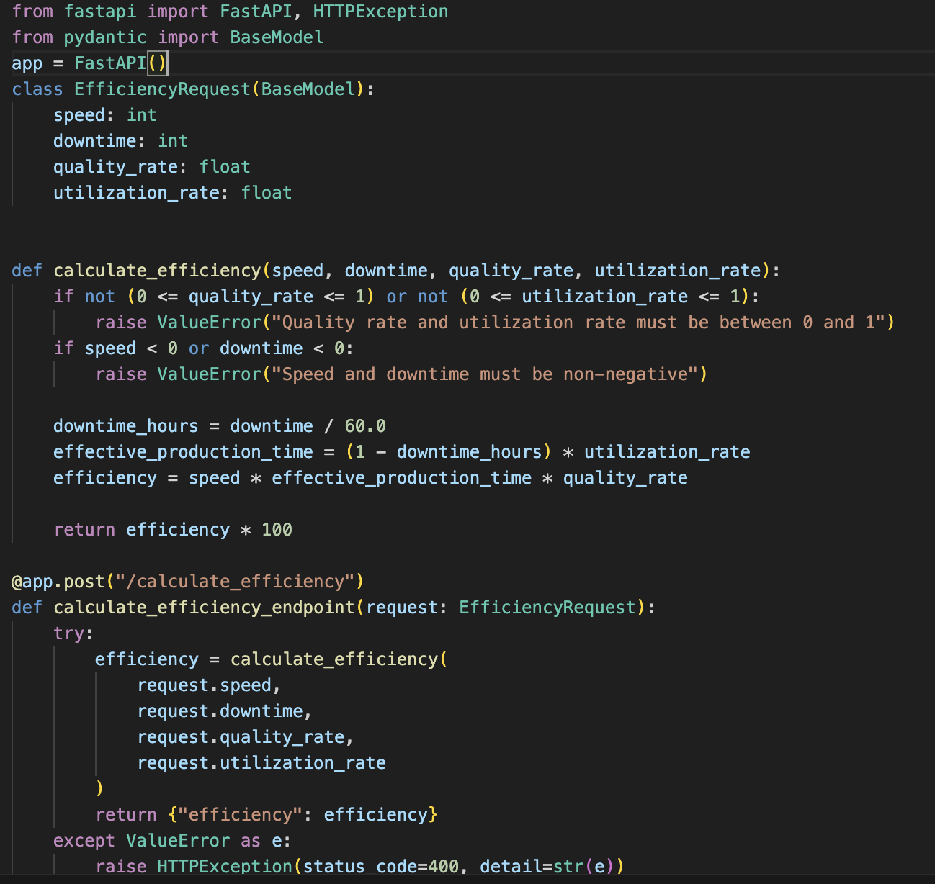
Exercise
Let's remember APIs and see how we can test them.
P&G DevSchool
Presenter:​Ana

Slide 10
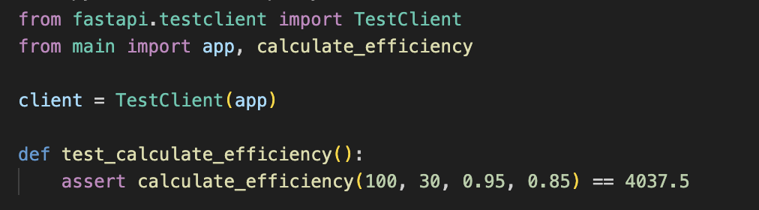
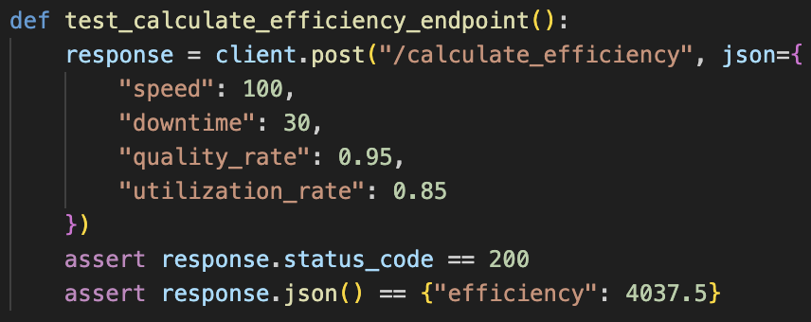
Exercise
Write a test for the calculate_efficiency method to verify that it correctly calculates the efficiency.
Modify the test so it checks that the /calculate_efficiency endpoint correctly calculates the efficiency when provided with valid input data.
P&G DevSchool
Presenter:​Ana

Slide 11
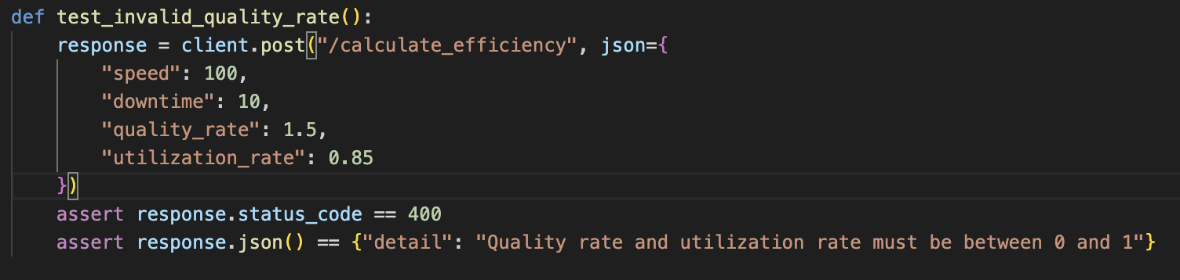
Exercise
Write a test for the /calculate_efficiency endpoint to verify that it returns a 400 status code and an appropriate error message when provided with an invalid quality_rate value.
P&G DevSchool
Presenter:​Ana

Slide 12
Exercise
Write a test for the /calculate_efficiency endpoint to verify that it returns a 400 status code and an appropriate error message when provided with a negative speed value.
P&G DevSchool
Presenter:​Ana

Slide 13
Unit testing
Mocks and Patches
Mocks: Objects that simulate the behavior of real objects in controlled ways. They are used to isolate the code being tested from external dependencies.
Patches: A way to temporarily replace parts of the code with mock objects during testing. This is useful for testing code that interacts with external systems or APIs.
P&G DevSchool
Presenter:​Ana

Slide 14
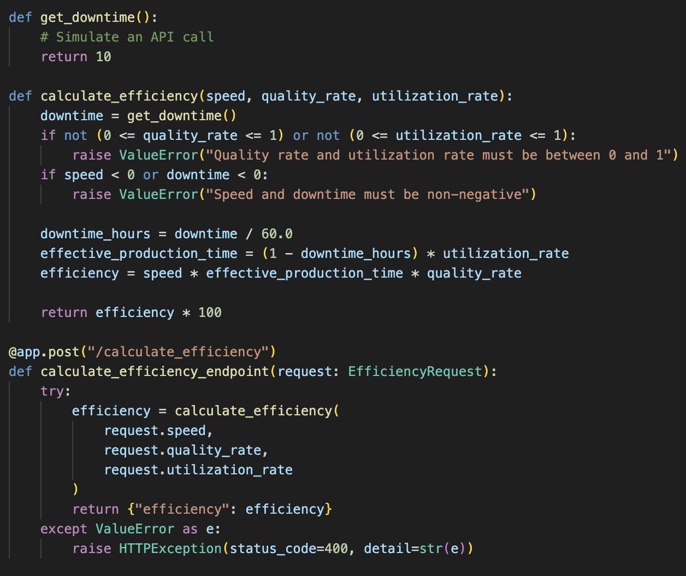
Exercise
Write a test for the calculate_efficiency function using pytest and unittest.mock to mock the get_downtime function.
P&G DevSchool
Presenter:​Ana

Slide 15
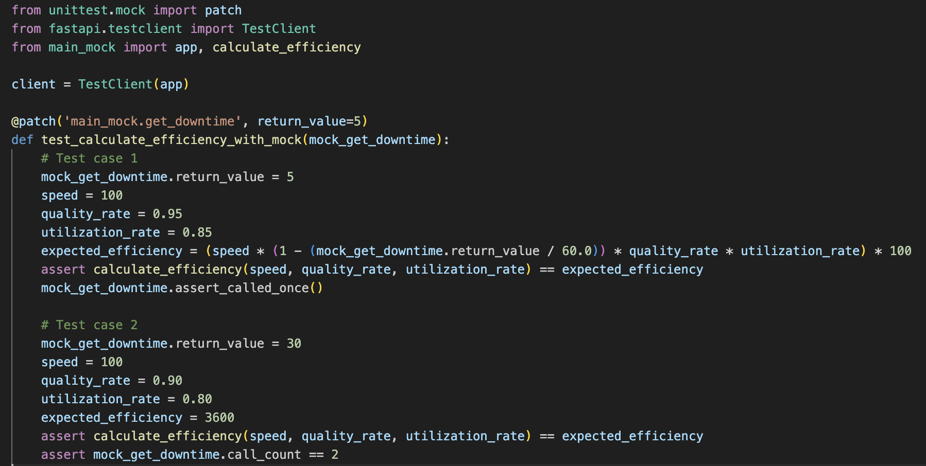
Exercise
P&G DevSchool
Presenter:​Ana

Slide 16
Unit testing
Fixtures and Parameterized tests
Fixtures: Functions that provide a fixed baseline for tests. They can be used to set up necessary preconditions and clean up after tests.
Parameterized Tests: Allow running the same test function with different arguments, making it easier to test multiple scenarios with less code.
P&G DevSchool
Presenter:​Ana

Slide 17
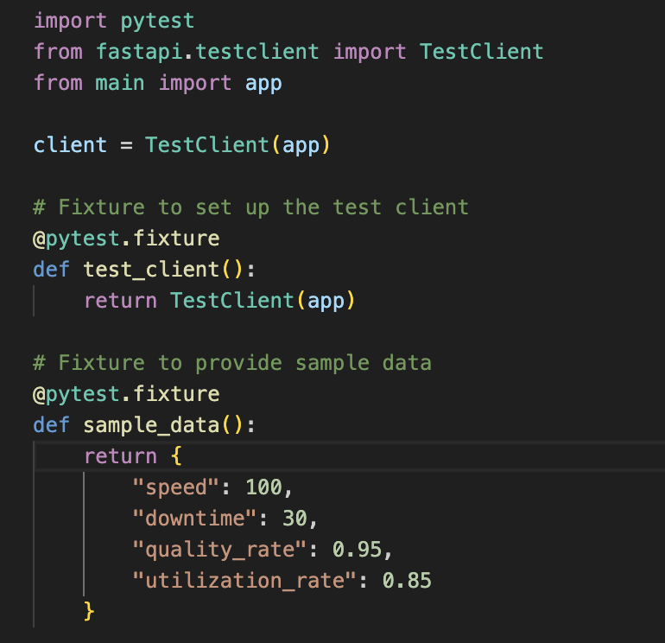
Exercise - Fixtures
Write a test for the /calculate_efficiency endpoint using fixtures for the test client and the sample data.
P&G DevSchool
Presenter:​Ana

Slide 18
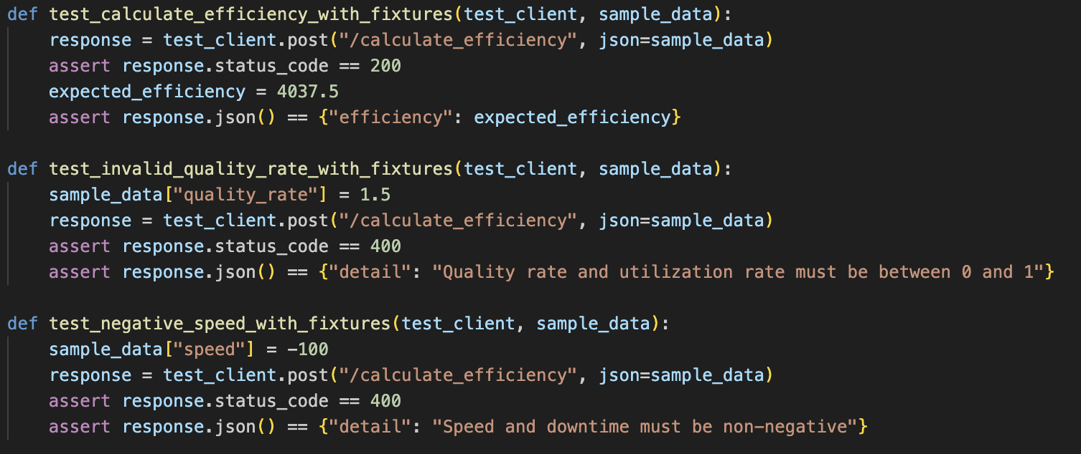
Exercise
P&G DevSchool
Presenter:​Ana

Slide 19
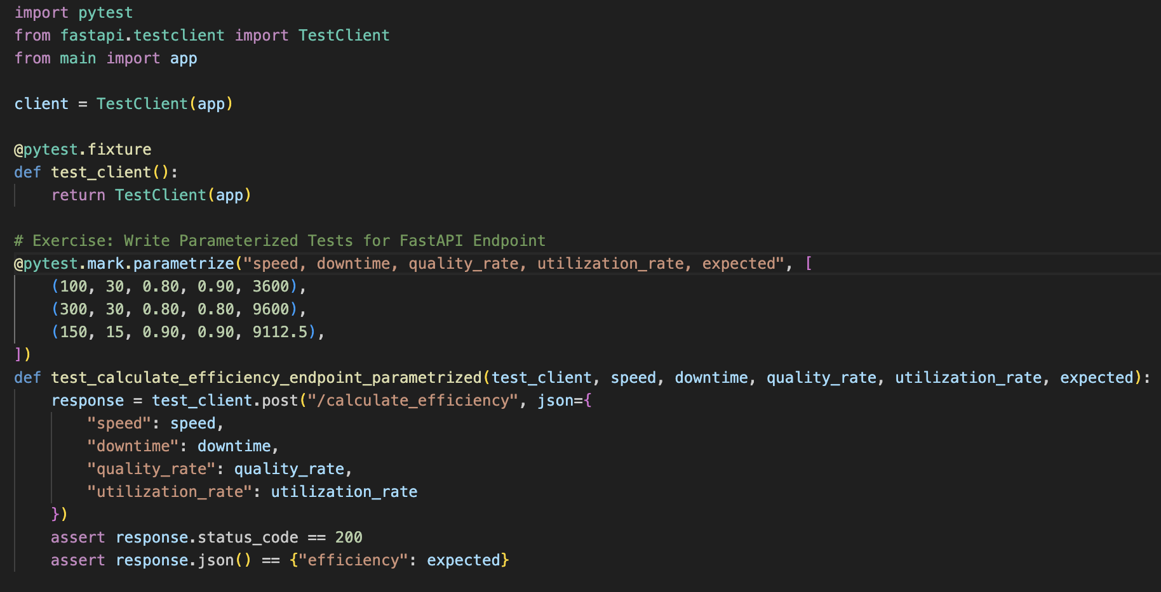
Exercise - Parameterized Tests
Write a test for the /calculate_efficiency endpoint using parameters.
P&G DevSchool
Presenter:​Ana

Slide 20
GitHub Actions
P&G DevSchool
Presenter:​Ana

Slide 21
Continuous Integration (CI):
What is CI?
Continuous Integration is a software development practice where developers frequently integrate their code changes into a shared repository.
Each integration is automatically verified by running tests and other checks to detect errors as early as possible.
The main goals of CI are to improve code quality, reduce integration problems, and enable faster development cycles.
P&G DevSchool
Presenter:​Ana

Slide 22
Continuous Delivery (CD)
What is CD?
Continuous Delivery is an extension of Continuous Integration that ensures code changes are automatically prepared for release to production.
With CD, every code change passes through a pipeline of automated tests, builds, and deployments, making it possible to release software at any time with minimal manual intervention.
P&G DevSchool
Presenter:​Ana

Slide 23
GitHub Actions
What are GitHub Actions?
GitHub Actions is a CI/CD platform that allows you to automate your software workflows directly in your GitHub repository.
It enables you to build, test, and deploy your code based on events such as push, pull requests, or scheduled intervals.
P&G DevSchool
Presenter:​Ana

Slide 24
GitHub Actions
Why GitHub Actions?
Automation: Automate repetitive tasks.
Integration: Seamlessly integrates with GitHub repositories.
Customization: Highly customizable workflows using YAML syntax.
P&G DevSchool
Presenter:​Ana

Slide 25
GitHub Actions
Configuring workflows to run tests
To run tests in GitHub Actions, you need to create a workflow file in your repository.
This file, written in YAML, defines the steps to be executed when certain events occur.
For example, you can configure a workflow to run your Python tests every time code is pushed to the repository.
P&G DevSchool
Presenter:​Ana

Slide 26
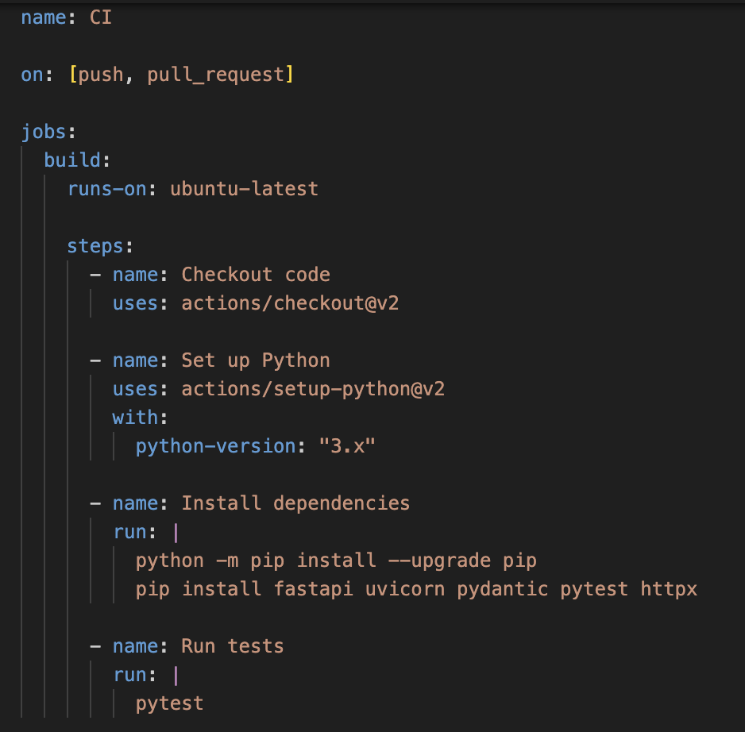
Task
Create a GitHub Actions workflow file to run pytest on your repository.
P&G DevSchool
Presenter:​Ana

Slide 27
GitHub Secrets
What are GitHub Secrets?
Secrets in GitHub Actions are encrypted environment variables that you can use to store sensitive information such as API keys, passwords, tokens, and other credentials.
These secrets are securely stored and can be accessed within your GitHub Actions workflows, ensuring that sensitive data is not exposed in your codebase.
P&G DevSchool
Presenter:​Ana

Slide 28
GitHub Secrets
Why GitHub Secrets?
Security: Secrets are encrypted and only accessible within the context of your workflows, reducing the risk of exposing sensitive information.
Convenience: Secrets can be easily managed and updated through the GitHub repository settings, making it simple to maintain and rotate credentials.
Compliance: Using secrets helps you comply with best practices and security policies by keeping sensitive information out of your source code.
P&G DevSchool
Presenter:​Ana

Slide 29
GitHub Secrets
GitHub Secrets Set Up
Navigate to your repository on GitHub.
Click on the "Settings" tab.
In the left sidebar, click on "Secrets and variables" and then "Actions".
Click the "New repository secret" button.
Enter a name for your secret in the "Name" field.
Enter the value of your secret in the "Value" field.
Click the "Add secret" button.
P&G DevSchool
Presenter:​Ana

Slide 30
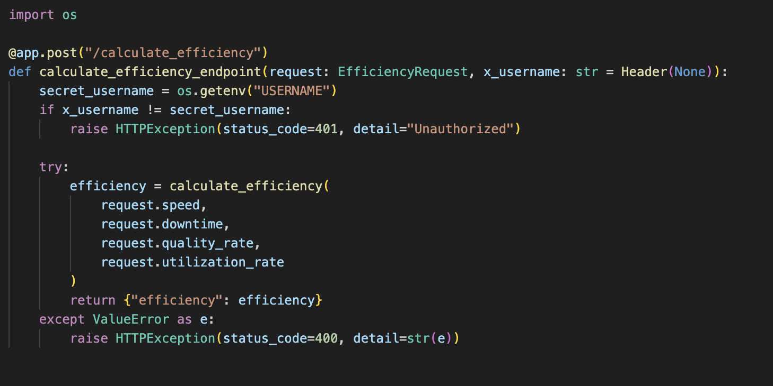
GitHub Secrets
Store a secret API key in GitHub Actions and use it in a workflow. The secret will be the username of the employee that has permissions to access the API. For this, you need to modify the FastAPI endpoint and the tests. The username is "user_name".
P&G DevSchool
Presenter:​Ana:

Slide 31
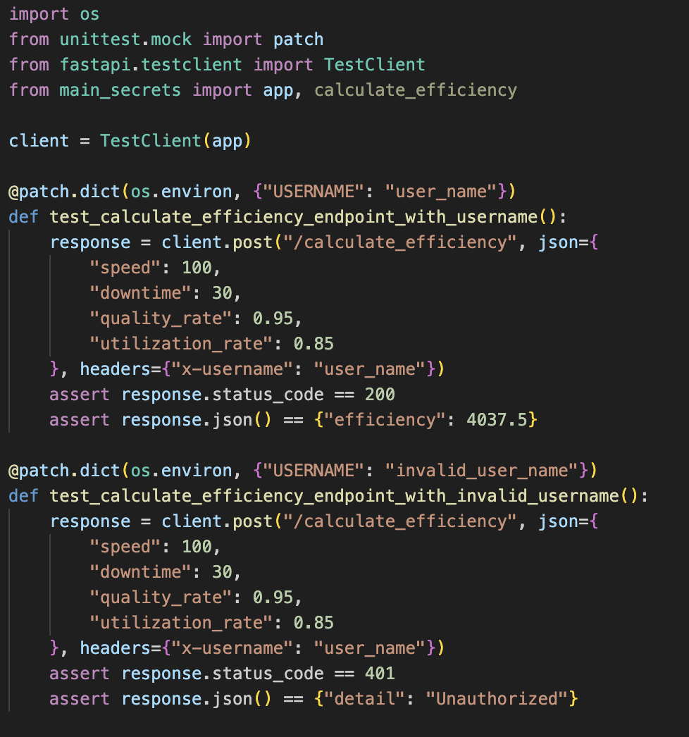
GitHub Secrets
P&G DevSchool
Presenter:​Ana:

Slide 32
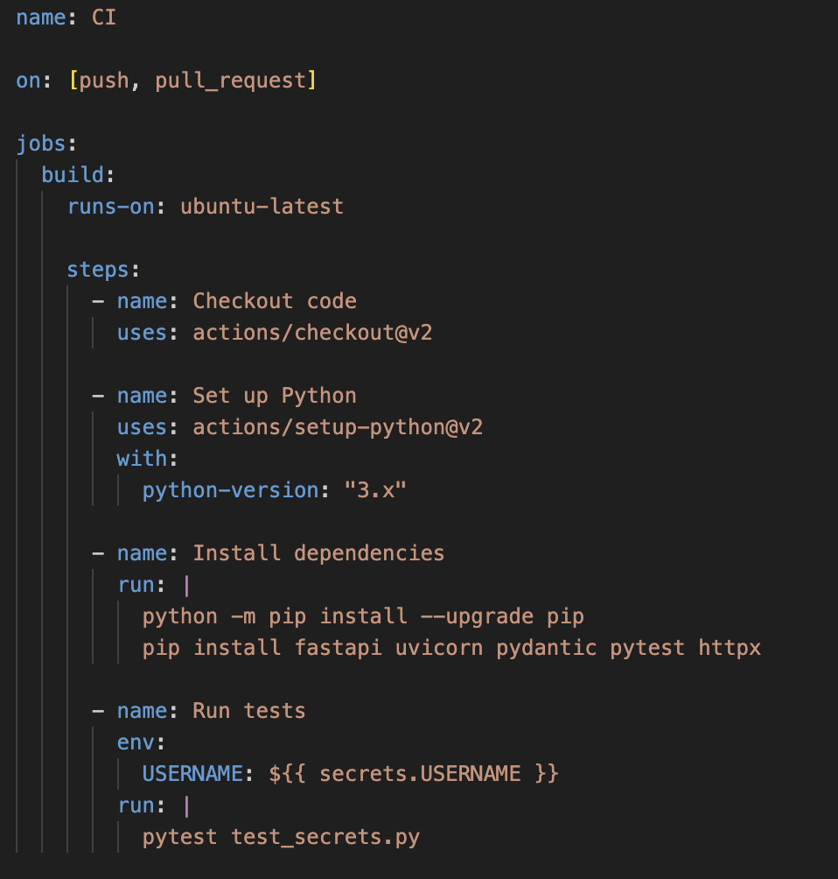
GitHub Secrets
P&G DevSchool
Presenter:​Ana

Slide 33
Best Practices for Testing and CI
Tips and best practices
Write Clear and Concise Tests: Ensure that tests are easy to understand and maintain.
Run Tests Frequently: Integrate tests into your CI pipeline to catch issues early.
Use Fixtures and Parameterization: Leverage pytest features to reduce code duplication and improve test coverage.
Secure Your Workflows: Manage secrets properly and follow security best practices to protect sensitive information.
P&G DevSchool
Presenter:​Ana

Slide 34
Testing and GitHub Actions
Thank you!
P&G DevSchool
Presenter:​Ana

